Slide 1
Composing in Primary Schools
Sue Walker

Slide 2
What does the National Curriculum say?
KS1:
Play tuned and untuned instruments musically
experiment with, create, select and combine sounds using the inter-related dimensions of music.
KS2:
Play and perform in solo and ensemble contexts, using their voices and playing musical instruments with increasing accuracy, fluency, control and expression
Improvise and compose music for a range of purposes using the inter-related dimensions of music
Listen with attention to detail and recall sounds with increasing aural memory
Use and understand staff and other musical notations

Slide 3
Model Music Curriculum
Year 1:

Slide 4
Model Music Curriculum
Year 4:

Slide 5
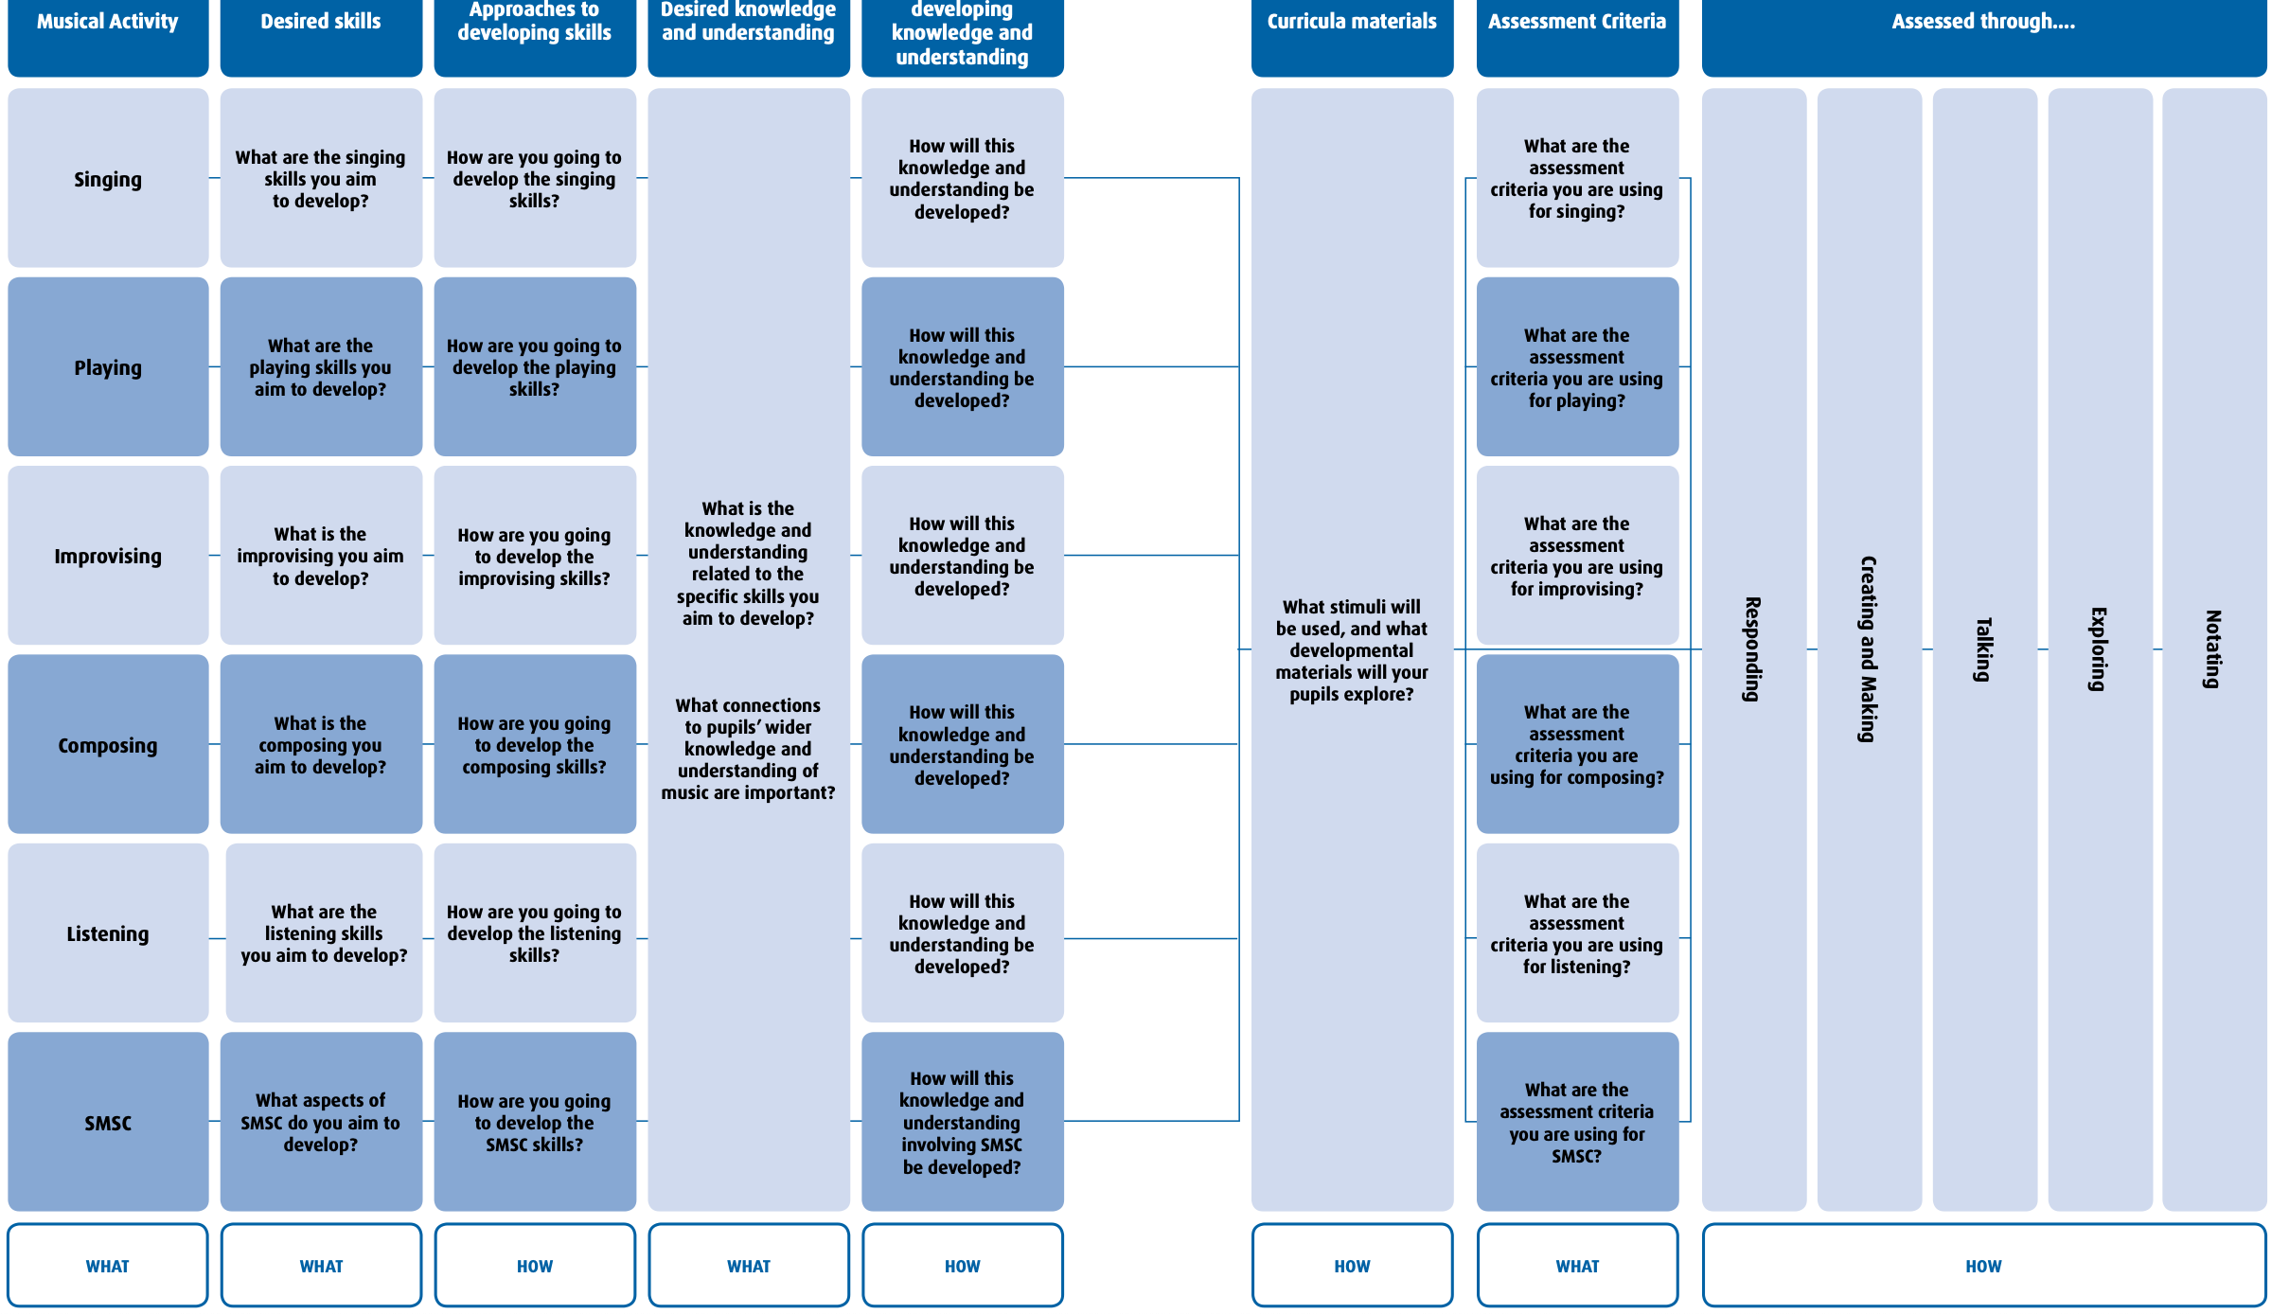
ISM revised Framework for curriculum, pedagogy and assessment. Daubney & Fautley 2019

Slide 6
Where can we find help and guidance?
ISM | Primary Music Toolkit (ismtrust.org) This is an amazing resource full of ideas but not prescribing what you must do
EYFS / KS1 Music: Teacher techniques - Composing melodies - BBC Teach A lovely resource with clear video guidance
Music KS2 / KS3: Composing a piece of music using unpitched percussion - BBC Teach A similar resource for KS2
Music Express/Charanga/Kapow (paid)
Oak Academy (free)
Music Mark have suggestions for Primary Music resources (various)
Musical Contexts (paid)
Bristol Plays Music – 5 a day recovery resource (free)
BBC Ten Pieces (free)

Slide 7
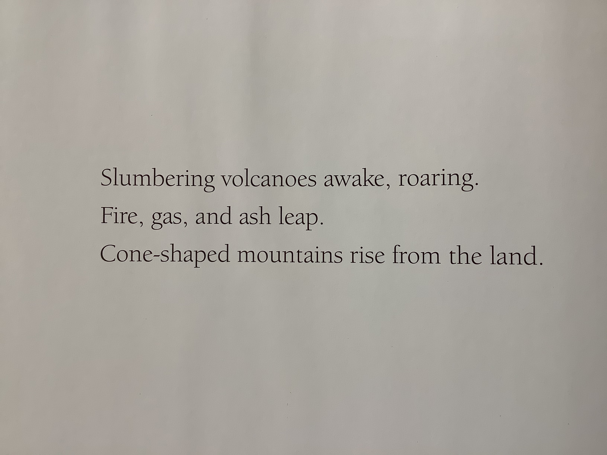
Sharing ideas
Topic related planning
Mountains in Year 4/5: creating compositions in response to description, focusing on structure and texture, relating to English text
Discussed each page and literary features of the text
Children spend a lesson looking at the words and how they could be represented by music
Play around with pattern and rhythm, timbre, dynamics, pitch, tempo
Start to improvise together and then create sounds which reflect the mood and words from their part of the story, considering the unit focus and skills progression

Slide 8
Sharing ideas
Stand-alone music unit of work, unrelated to topic
Examples such as:
Theme and Variations
Pentatonic scale
Ostinato, beat and rhythm
Balinese Gamelan
Looping and remixing

Slide 9
swalker@bosbury.hereford.sch.uk @Sue_MusicEd

